Slide 1

Movie Data Analysis
by Gulnaz Nursultanova

Slide 2
Description
General information:
Attributes:
dataset | data | description of project
Kaggle, IMDB | 1000 movies | analyzing a database of movies (IMDB) and extracting various insights from it
name | description
title | the name of the movie
genre | genre of the movie
description | description of the movie
director | director of the movie
actors | actors in the movie
year | year of release
runtime_min | the duration of the movie
rating | rating of the movie
votes | vote for the movie
revenue_mln | revenue in millions
metascore | rating critics

Slide 3
Tasks
1. Top 10 movies with the highest rating:
Create a list of the top 10 movies with the highest rating.
2. Top 5 directors with the highest average metascore of movies:
Identify the top 5 directors with the highest average metascore for their movies.
3. Movies with the highest box office revenue:
Compile a list of movies with the highest box office revenues.
4. Most popular genres among the audience:
Determine the most popular genres among the audience.
5. Number of movies and average rating by release year:
Calculate the number of movies and the average rating by release year.

Slide 4
Tasks
6. Top popular genres by rating:
Identify the top popular genres based on their ratings.
7. Number of movies in each votes category:
Count the number of movies in each votes category (grouped into categories "Low“, "Moderate" and "High").
8. The minimum and maximum rating in each votes category:
Determine the minimum and maximum rating in each votes category.
9. Information about the shortest and longest film:
Prepare information about the shortest and longest films.

Slide 5
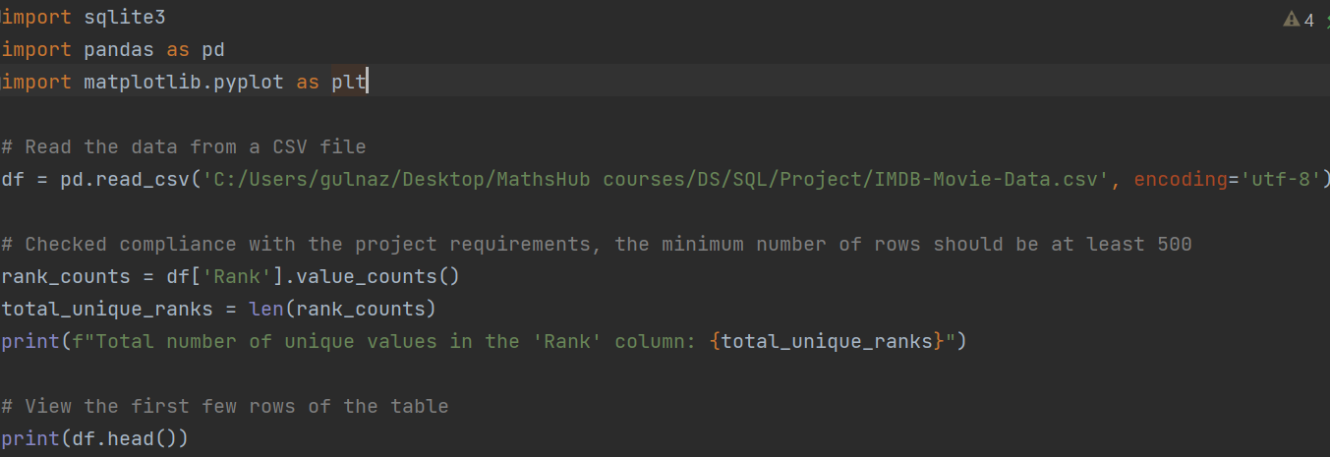
Initial data processing
Renaming columns following naming convention using Python in PyCharm
Removing duplicate rows
Dealing with null/missing values

Slide 6
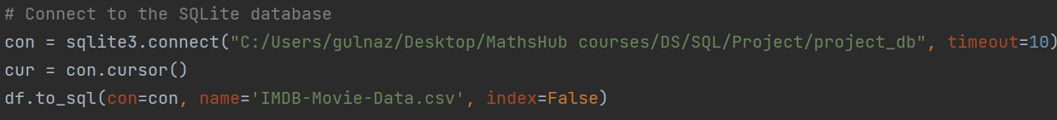
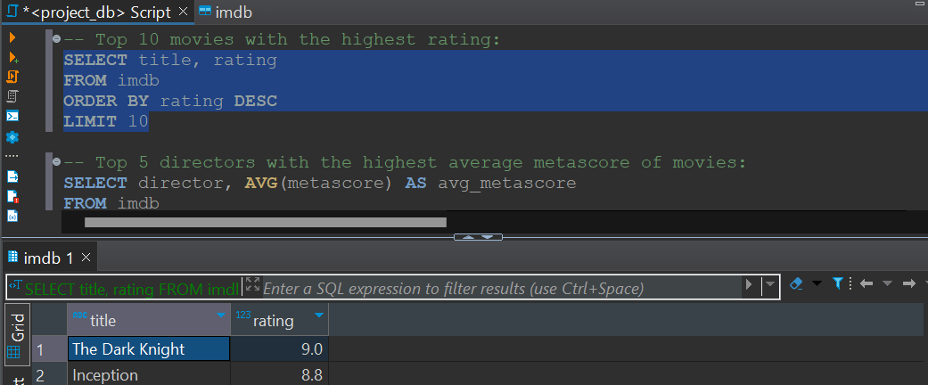
Connection to database
Connection to the database and data loading
Completing the tasks described above using SQLite

Slide 7
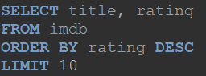
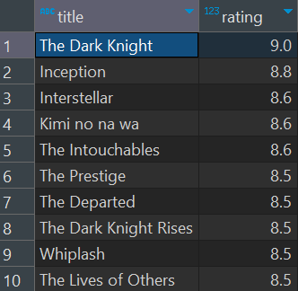
Results
1. Top 10 movies with the highest rating in descending order with revenue

Slide 8
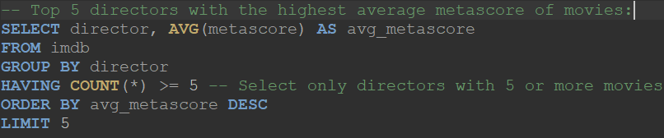
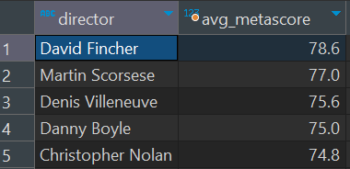
Results
2. Top 5 directors with the highest average movie ratings

Slide 9
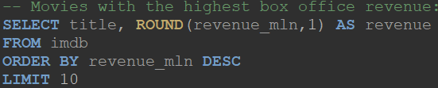
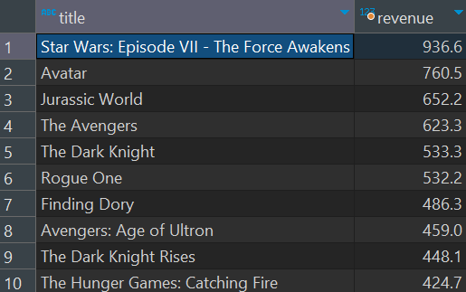
Results
3. 10 movies with the highest box office revenue, displaying their titles and revenue in descending order.

Slide 10
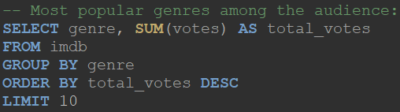
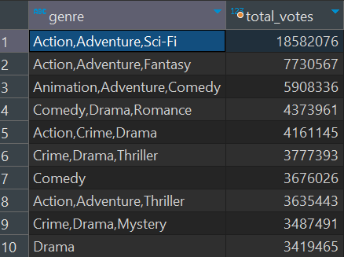
Results
4. The top 10 most popular genres among the audience based on the total number of votes.

Slide 11
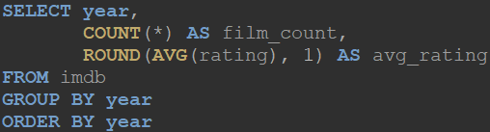
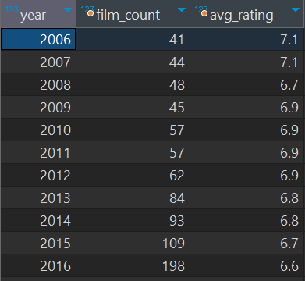
Results
5. The number of movies and their average rating by release year.

Slide 12
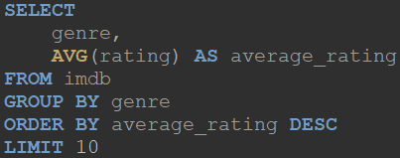
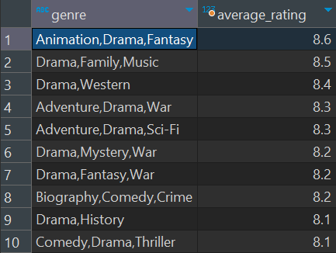
Results
6. Top 10 popular genres based on the average movie rating. The results are grouped by genres and sorted in descending order of the average rating.

Slide 13
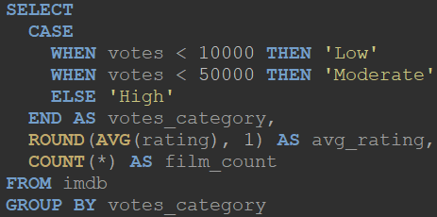
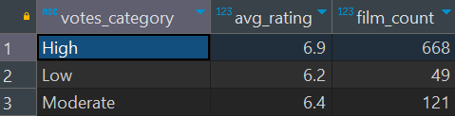
Results
7. It calculates the number of movies in each of the three vote categories (low, moderate, high) and their average rating.

Slide 14
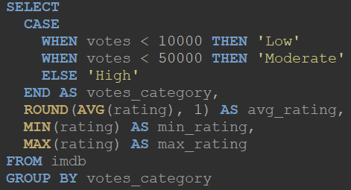
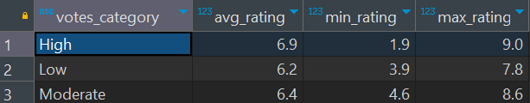
Results
8. The minimum and maximum movie ratings in each of the three vote categories (low, moderate, high). The results are grouped by vote categories and display the average rating, minimum, and maximum rating for each category. This allows for a more detailed examination of the distribution of movie ratings based on the number of votes

Slide 15
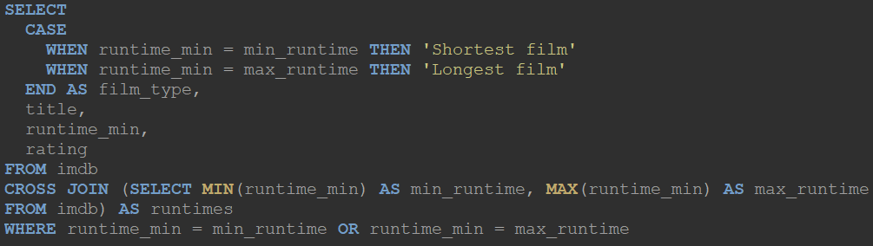
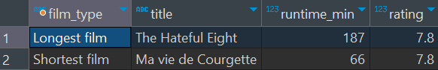
Results
9. Information about the shortest and longest movies. The query compares the duration of movies with the minimum and maximum duration values and displays the titles, durations, and ratings of these movies, indicating whether a movie is the shortest or longest.

Slide 16
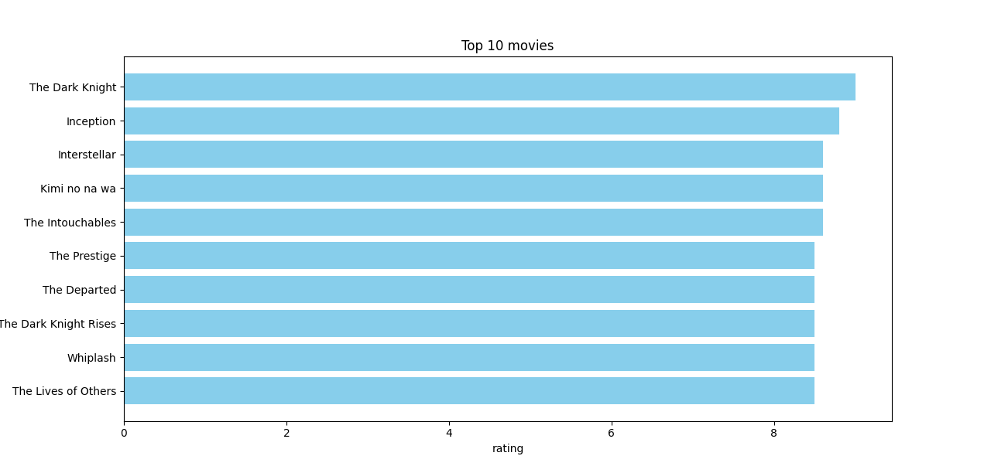
Vizualization
Visualizations have been created from the obtained dataset and an SQL query has been executed from Python
Top 10 movies:

Slide 17
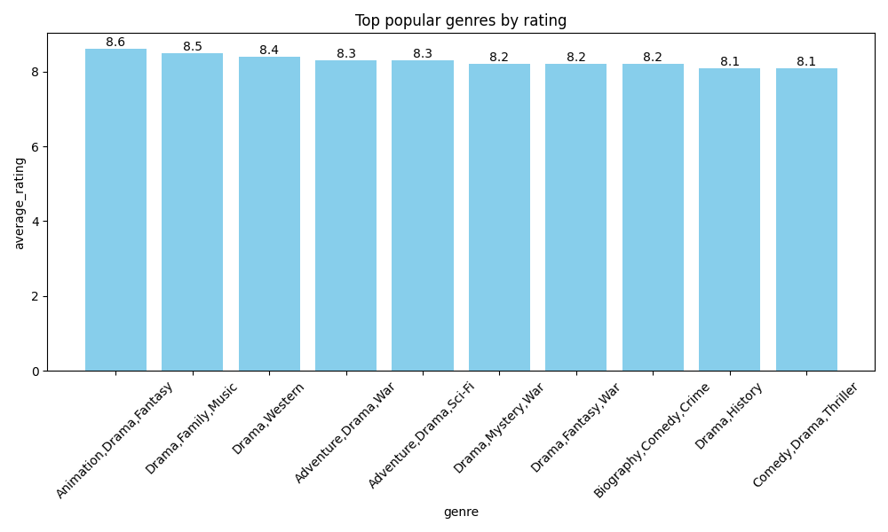
Top popular genres by rating

Slide 18
Thank you!

